Slide 1
Tiny Mindfulness Habits
Session 2

Slide 2
Practice to start our session today…

Slide 3
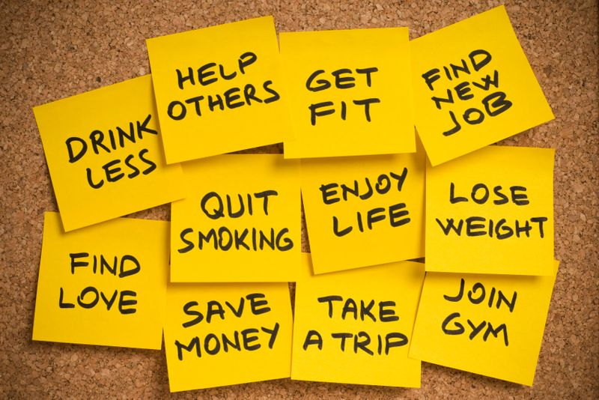
Easier said than done….

Slide 4
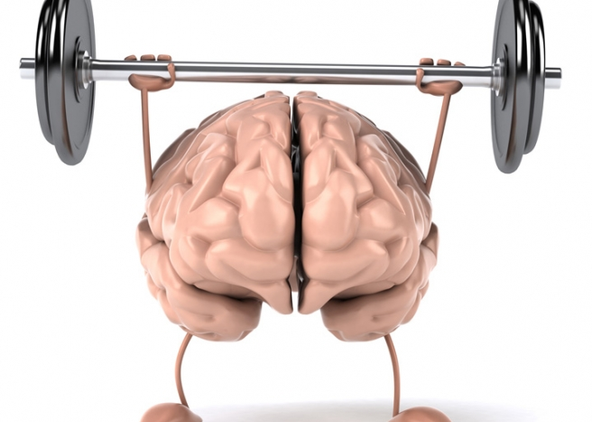
How can we live more in the moment?
How can we be more aware?
The work of mindfulness

Slide 5
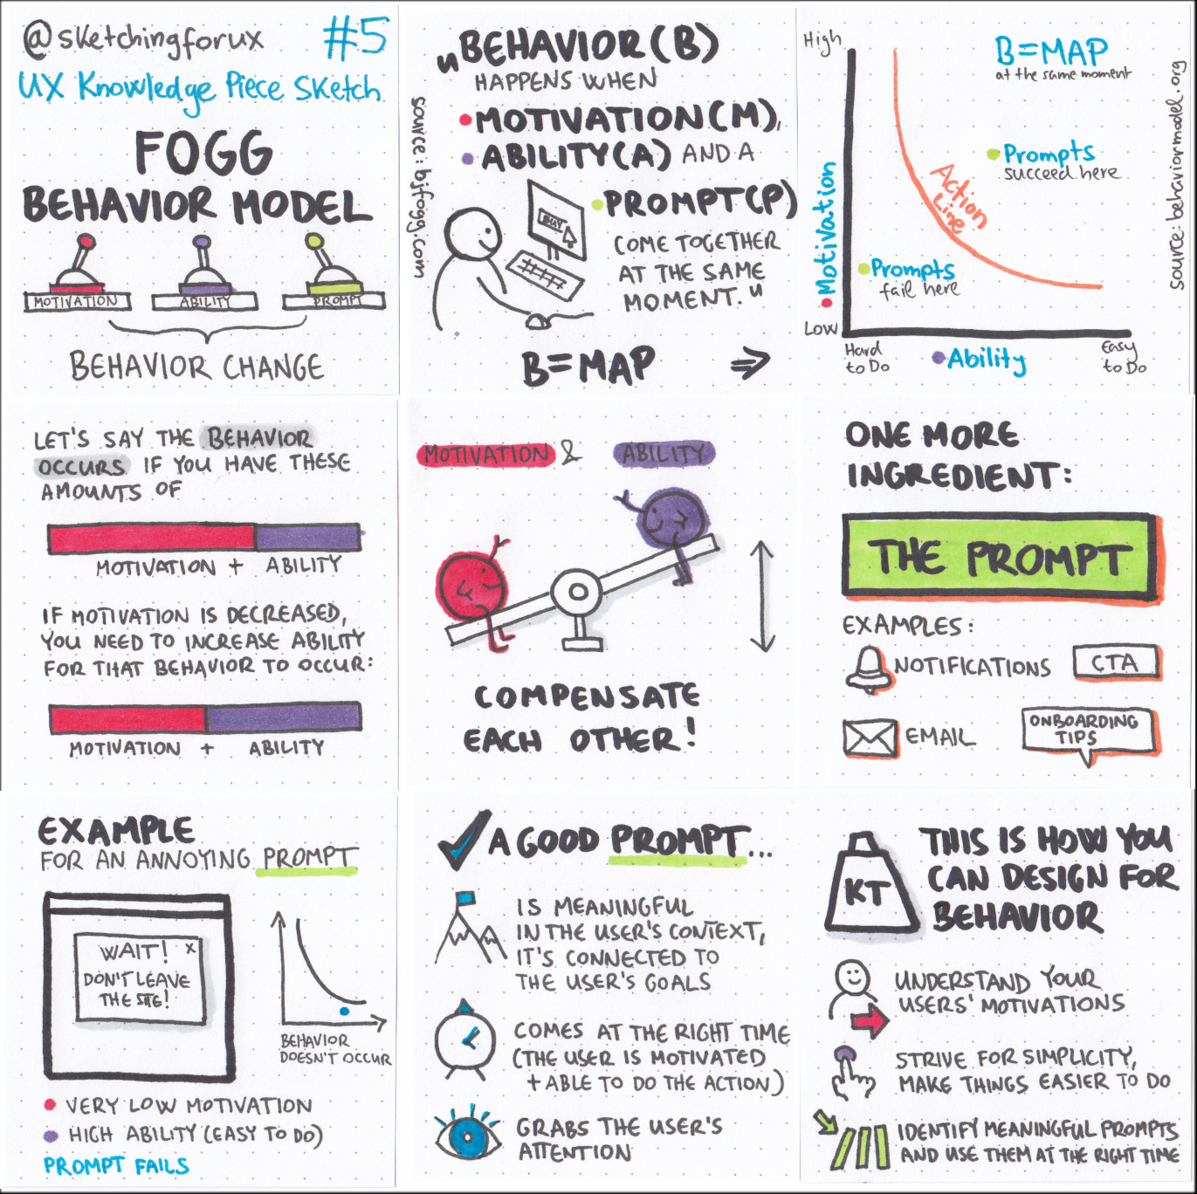
The Fogg Behavioural Model
B=MAP
“Behavior (B) happens when motivation (M), ability (A) and a prompt (P) come together at the same moment.” (Source:www.bjfogg.com)

Slide 6
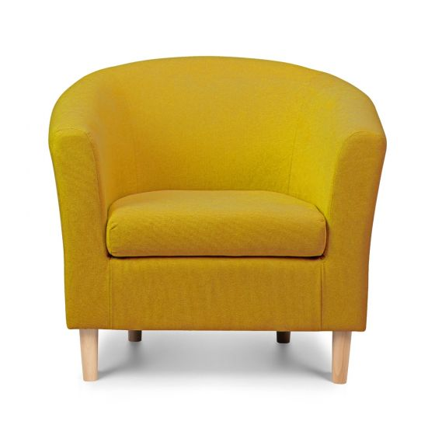
Habits and prompts
Notes:
.

Slide 7
The Fogg Behavioural Model
Motivation
Really
want
to do
Will do it
B=MAP
“Behavior (B) happens when motivation (M), ability (A) and a prompt (P) come together at the same moment.” (Source:www.bjfogg.com)
Line of
Action
Don’t
want
to do
Won’t do it
Ability
Hard
to do
Easy
to do

Slide 8

Personal care habits
Motivation
Really
want
to do
Brushing my teeth
Don’t
want
to do
Ability
Hard
to do
Easy
to do

Slide 9
Personal care habits
Motivation
Really
want
to do
Brushing my teeth
Don’t
want
to do
Ability
Hard
to do
Easy
to do

Slide 10

Personal care habits
Motivation
Having a shower
Really
want
to do
Don’t
want
to do
Ability
Hard
to do
Easy
to do

Slide 11
Personal care habits
Motivation
Having a shower
Really
want
to do
Don’t
want
to do
Ability
Hard
to do
Easy
to do

Slide 12
Smart design, not willpower
Clarify your aspiration (motivation)
Anchor behaviour (prompt)
Develop a tiny mindfulness habit (ability)
One more final element to help keep it going.

Slide 13

Celebration
Feelings wire in habits
Individualised
Something said or done ( internally or externally) that makes you feel good, creates a feeling of success.
Celebrate remembering to do the habit (even if you didn’t actually manage to do it).
Celebrate small wins.

Slide 14
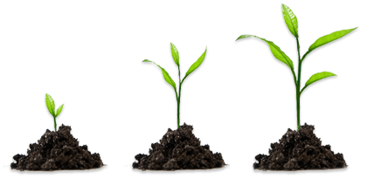
Suggestions for between session work….
Be curious.
Pick a couple of tiny things that you would like to prioritise for change .
Keep track of how you are doing.
Work out how best to celebrate successes.
Remember, change is a process…!

